Slide 1
Survey Results
Notes:
These results shouldn’t surprise us, women are more likely than men to respond to surveys, as are older individuals.

Slide 2
Survey Results
Notes:
Notable in the survey: only one respondent used public transportation as primary form of transportation.

Slide 3
Survey Results
Notes:
2 other responses: Starke; Will & Cook
2/3 travel rural KIRPC roads DAILY

Slide 4
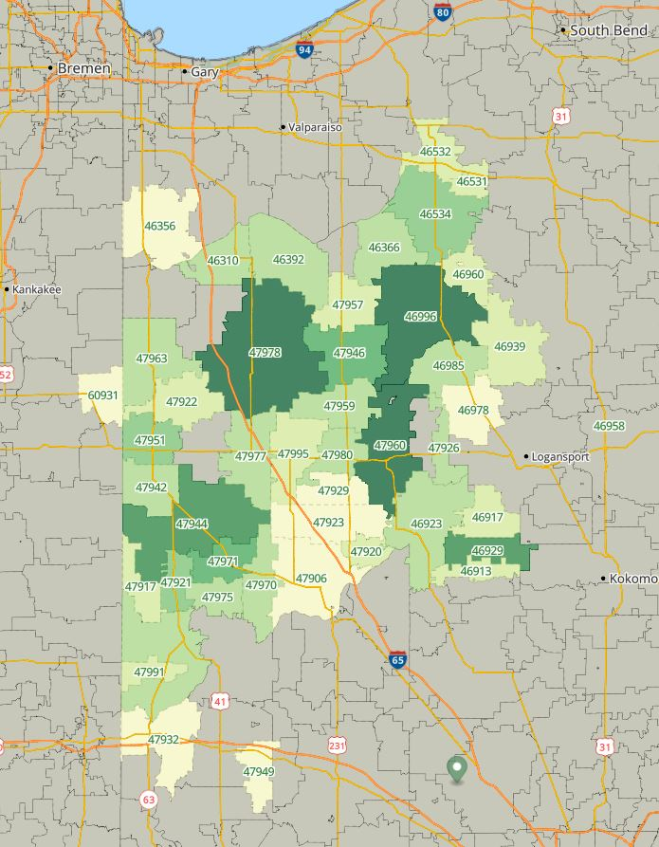
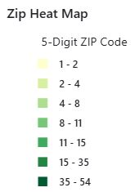
Survey Results
Where do you live?
Notes:
This map shows the zip codes where respondents live.

Slide 5
Survey Results

Slide 6
Survey Results

Slide 7
Survey Results

Slide 8
Survey Results
Notes:
This data is broken out by county, with the county having the most responses to this question at the top and the fewest responses at the bottom.

Slide 9
Survey Results

Slide 10
Survey Results

Slide 11
Survey Results

Slide 12
Survey Results
Notes:
~70% of people believe a Safety Action Plan will improve safety.

Slide 13
Survey Results
Notes:
Only 6% of respondents oppose using federal grants for road safety.

